Slide 1

DISCRETE MATHEMATICS AND APPLICATIONS
CHAPTER 4
ADVANCE COUNTING TECHNIQUE
Notes:
DISCRETE MATHEMATICS & ITS APPLICATIONS
CHAPTER 2

Slide 2

2.1 RECURRENCE RELATIONS
CHAPTER 2 ADVANCE COUNTING TECHNIQUE
Aim
Define and develop a recurrence relation
Model a problem using recurrence relation
Find the solution of recurrence relations
with the given initial conditions
Notes:
DISCRETE MATHEMATICS & ITS APPLICATIONS
CHAPTER 2

Slide 3
2.1 RECURRENCE RELATION
Motivation
  The number of bacteria in a colony doubles every hour. If the colony begins with 5 bacteria, how many will be present in n hours?
  Let an : the number of bacteria at the end of n hours
  Then;
  an = 2an-1, a0=5
  What we are doing actually?
  We find a formula/model for an (the relationship between an and a0) – this is called recurrence relations between the term of sequence.
Solution:
By using recursive definition
Since bacteria double every hour Initial condition
Notes:
DISCRETE MATHEMATICS & ITS APPLICATIONS
CHAPTER 2

Slide 4
2.1 RECURRENCE RELATION
Recursive (Inductive) Definitions
Recursion – a process to define an object explicitly(openly)
The object can be a sequence, function or set
The ideas – construct new elements from known elements.
Process – specify some initial elements in a basis step and provide a rule for constructing new elements from those we already have in the recursive step.
Mathematical Induction can be used to prove the result.
The given complex problem
Can be
solved if
This simple version can be solved
Can be
solved if
Can be
solved if
This simple version can be solved
  an = 2an-1 an-1 = 2an-2, a1 = 2a0, a0=5
Notes:
DISCRETE MATHEMATICS & ITS APPLICATIONS
CHAPTER 2

Slide 5
2.1 RECURRENCE RELATION
Recurrence Relation
A recurrence relation for the sequence {an} is an equation that expresses an in terms of one or more of the previous terms of the sequence, namely, a0, a1,…, an-1, for all integers n with n ≥ n0, where n0 is a nonnegative integer.
A sequence is call solution of a recurrence relation if its term satisfy the recurrence relation.
an = 2an-1
a0 = 5
Recurrence relation
Recursive
definition
Initial condition
A recursive algorithm provides the solution of a problem of size n in term of the solutions of one or more instances(examples or cases) of the same problem in smaller size.
The initial condition specify the terms that precede the first term where
the recurrence elation takes effect.
Notes:
DISCRETE MATHEMATICS & ITS APPLICATIONS
CHAPTER 2

Slide 6
2.1 RECURRENCE RELATION
Example
Let {an} be a sequence that satisfies the recurrence relation an = an-1 – an-2 for n = 2, 3,4, and suppose that a0 =3 and a1 = 5.
List the first four term.
a0 = 3
a1 = 5
a2 = a1 – a0 = ___________________
a3 = __________________________
What is a5?
a5 = __________________________
Notes:
DISCRETE MATHEMATICS & ITS APPLICATIONS
CHAPTER 2

Slide 7
2.1 RECURRENCE RELATION
Example
Determine whether {an} where an = 3n for every nonnegative integer n, is a solution of recurrence relation an = 2an-1 – an-2 for n = 2, 3, 4, …
Suppose that an = 3n for every nonnegative integer n, Then for n ≥ 2;
2an-1 – an-2 = ___________________
Therefore,
Determine whether {an} where an = 5 for every nonnegative integer n, is a solution of recurrence relation an = 2an-1 – an-2 for n = 2, 3, 4, …
2an-1 – an-2 = ___________________
Notes:
DISCRETE MATHEMATICS & ITS APPLICATIONS
CHAPTER 2

Slide 8
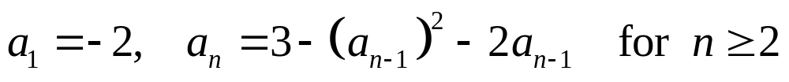
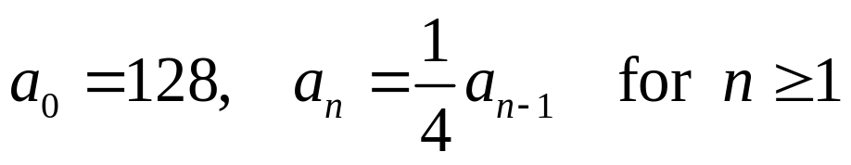
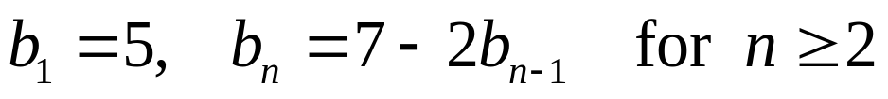
2.1 RECURRENCE RELATION
EXERCISE 1
Let an denotes the nth term of a sequence satisfying the given initial condition (s) and the recurrence relation. Compute the first four terms of the sequence.
A
B
C
D
E
Notes:
DISCRETE MATHEMATICS & ITS APPLICATIONS
CHAPTER 2

Slide 9
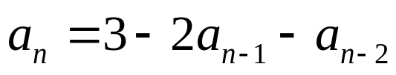
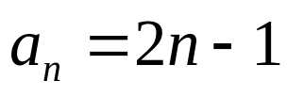
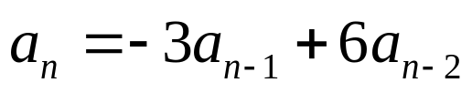
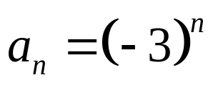
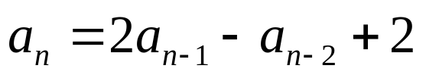
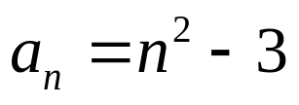
2.1 RECURRENCE RELATION
EXERCISE 1
Is the sequence {an} a solution of the if
Is the sequence {an} a solution of the if
Show that the sequence {an} is a solution of the recurrence
relation if
Notes:
DISCRETE MATHEMATICS & ITS APPLICATIONS
CHAPTER 2

Slide 10
2.1 RECURRENCE RELATION
Modeling with Recurrence Relation
We can use recurrence relation to model a wide variety of problems such as
  Finding a compound interest
  Counting a population of rabbits
  Determining the number of moves in the Tower of Hanoi puzzle
  Counting bit strings
  etc…
Notes:
DISCRETE MATHEMATICS & ITS APPLICATIONS
CHAPTER 2

Slide 11
2.1 RECURRENCE RELATION
Example 1: Compound interest
Suppose that a person deposits 10,000 birr in a savings account at a bank yielding 11% per year with interest compounded annually. Define recursively the compound amount in the account at the end of n years.
  Let an : the amount in the account after n years
  Then;
  an = (compound amount at the end of (n -1)th years)
  + (interest for the nth years)
  an = an-1 + 0.11an-1
  = 1.11 an-1
  With initial condition; a0 = 10,000
Solution:
Notes:
DISCRETE MATHEMATICS & ITS APPLICATIONS
CHAPTER 2

Slide 12
2.1 RECURRENCE RELATION
Example 2: Population of rabbits
A young pair of rabbits (one of each sex) is placed on an island. A pair of rabbits does not breed until they are 2 months old. After they are 2 months old, each pair of rabbits produces another pair each month. Find a recurrence relation for the numbers of pairs of rabbits on the island after n months if all the rabbits alive.
  Let fn : the numbers of pairs of rabbits on the island after n months
  Then;
  fn = (number of pairs of rabbits in (n -1)th months)
  + (number of newborn pairs of rabbits)
  fn = fn-1 + fn-2
  With initial condition; f1 = 1 and f2 = 1 ; n ≥ 3
Solution:
WHY???
Notes:
DISCRETE MATHEMATICS & ITS APPLICATIONS
CHAPTER 2

Slide 13
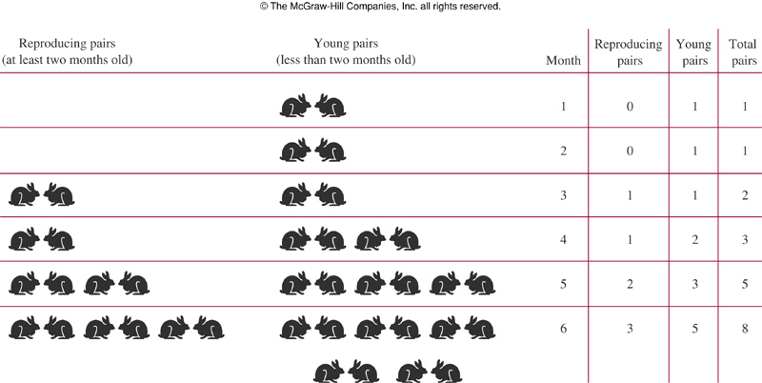
2.1 RECURRENCE RELATION
Example 2: Population of rabbits
Notes:
DISCRETE MATHEMATICS & ITS APPLICATIONS
CHAPTER 2

Slide 14
2.1 RECURRENCE RELATION
Example 3: Tower of Hanoi
Popular Puzzle invented by Edouard Lucas
(French Mathematician, late 19th century)
RULES OF PUZZLE:
  Suppose we have 3 pegs labeled A, B, C and a set of disks of different sizes.
  These disks are arranged from the largest disk at the bottom to the smallest disk at the top (1 to n disks) on peg A.
  The goal: to have all disks on peg C in order of size, with the largest on the bottom.
  Only one disk is allow to move at a time from a peg to another.
  Each peg must always be arranged from the largest at the bottom to the smallest at the top
Notes:
DISCRETE MATHEMATICS & ITS APPLICATIONS
CHAPTER 2

Slide 15
2.1 RECURRENCE RELATION
Example 4: Tower of Hanoi
ILLUSTRATION: SOLUTION
Let Hn :
the numbers of
moves with n disks
n disks
A
B
C
Initial Position in the Tower of Hanoi
n-1 disks
transfer the top of
n-1 disks to peg B
A
B
C
Hn-1 moves
Intermediate Position in the Tower of Hanoi
Notes:
DISCRETE MATHEMATICS & ITS APPLICATIONS
CHAPTER 2

Slide 16
2.1 RECURRENCE RELATION
Example 4: Tower of Hanoi
ILLUSTRATION: SOLUTION
Moves the largest
disk to peg C
1 disks
1 move
A
B
C
Intermediate Position in the Tower of Hanoi
n disks
transfer the top of
n-1 disks to peg B
A
B
C
Hn-1 moves
Last Position in the Tower of Hanoi
Notes:
DISCRETE MATHEMATICS & ITS APPLICATIONS
CHAPTER 2

Slide 17
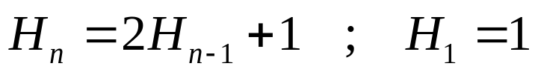
2.1 RECURRENCE RELATION
Example 4: Tower of Hanoi
Solution (continue):
Thus the number of moves is given by:
Where:
transfer the top of
n-1 disks to peg B
Moves the largest
disk to peg C
transfer the top of
n-1 disks to peg B
Hn-1 moves
+
1 move
+
Hn-1 moves
Notes:
DISCRETE MATHEMATICS & ITS APPLICATIONS
CHAPTER 2

Slide 18
2.1 RECURRENCE RELATION
Example 5: Bit Strings
Find a recurrence relation and give initial conditions for the number of bit strings of length n that do not have two consecutive 0s. How many bit strings are there of six length?
  Let an : number of bit strings of length n that do not have two
  consecutive 0s
  Then;
  an = (number of bit strings of length n-1 that do not have
  two consecutive 0s)
  + (number of bit strings of length n-2 that do not have
  two consecutive 0s)
  an = an-1 + an-2 ; n ≥ 3
  With initial condition;
  a1 = 2, both strings of length 1 do not have consecutive 0s ( 0 and 1)
  a2 = 3, the valid strings only 01, 10 and 11
Solution:
Solve yourself
Notes:
DISCRETE MATHEMATICS & ITS APPLICATIONS
CHAPTER 2

Slide 19
CHAPTER 2 ADVANCE COUNTING TECHNIQUE
2.2 SOLVING RECURRENCE RELATION
Solve a recurrence relation using iterative
method
Solve a linear homogeneous recurrence
relation with constant coefficients
Solve a linear nonhomogeneous recurrence
relation with constant coefficients
Notes:
DISCRETE MATHEMATICS & ITS APPLICATIONS
CHAPTER 2

Slide 20
2.2 SOLVING RECURRENCE RELATION
1. Iterative Method
Solving the recurrence relation for a function f means finding an explicit formula for f (n). The iterative method of solving it involves two steps:
  Apply the recurrence formula iteratively and look for the pattern to predict an explicit formula
    Forward: start from a0 to an
    Backward : start from an to a0
  Use Induction to prove that the formula does indeed hold for every possible value of the integer n.
Notes:
DISCRETE MATHEMATICS & ITS APPLICATIONS
CHAPTER 2

Slide 21
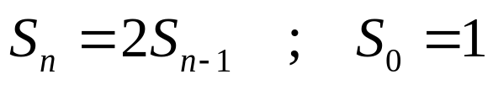
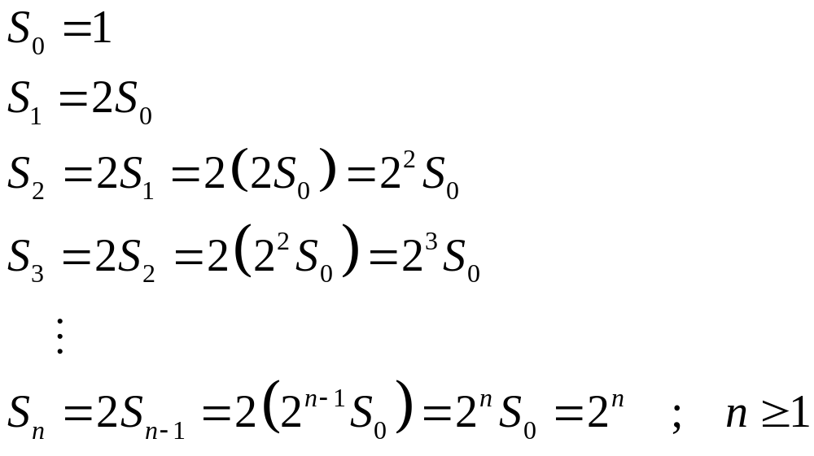
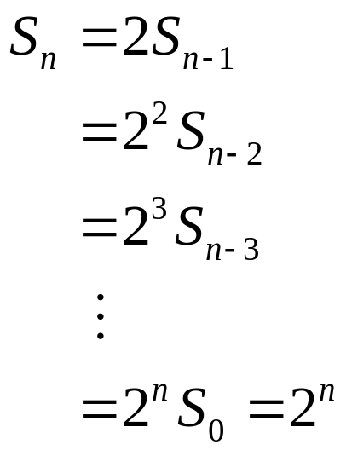
2.2 SOLVING RECURRENCE RELATION
Example 1 (a): Iterative Method
Using the iterative method, predict a solution for the following recurrence relation with the given initial condition.
Solution: (FORWARD)
Solution: (BACKWARD)
Notes:
DISCRETE MATHEMATICS & ITS APPLICATIONS
CHAPTER 2

Slide 22
2.2 SOLVING RECURRENCE RELATION
Example 2: Compound interest
Suppose that a person deposits 10,000 birr in a savings account at a bank yielding 11% per year with interest compounded annually. How much will be in the account after 30 years?
  Let an : the amount in the account after n years
  Then;
  an = (compound amount at the end of (n -1)th years)
  + (interest for the nth years)
  an = an-1 + 0.11an-1
  = 1.11 an-1 , n ≥ 1
  With initial condition; a0 = 10,000 birr
Solution:
Notes:
DISCRETE MATHEMATICS & ITS APPLICATIONS
CHAPTER 2

Slide 23
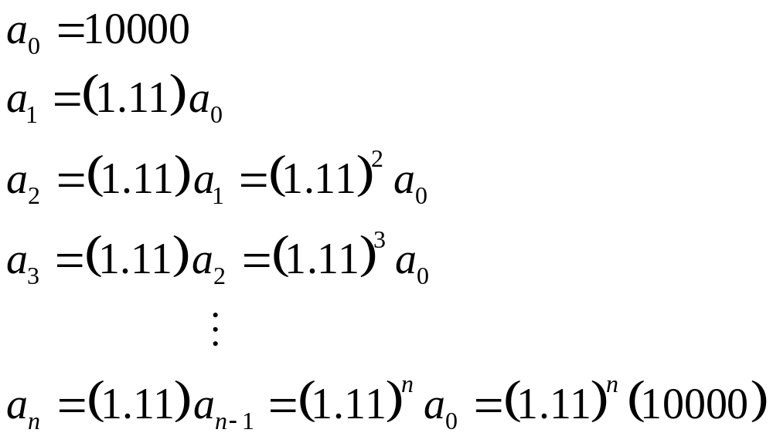
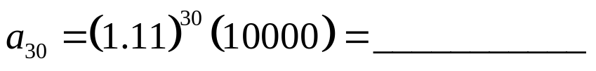
2.2 SOLVING RECURRENCE RELATION
Example 2: Compound interest
Solution (continue):
By iterative approach:
Thus, after 30 years the amount in the account will be:
PROVE BY INDUCTION !
Notes:
DISCRETE MATHEMATICS & ITS APPLICATIONS
CHAPTER 2

Slide 24
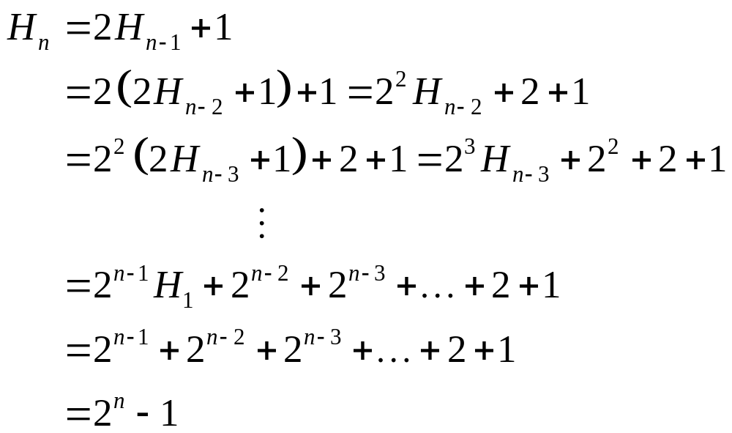
2.2 SOLVING RECURRENCE RELATION
Example 3: Tower of Hanoi
The number of moves is given by:
By iterative approach:
PROVE BY INDUCTION !
Notes:
DISCRETE MATHEMATICS & ITS APPLICATIONS
CHAPTER 2

Slide 25
2.2 SOLVING RECURRENCE RELATION
1st or 2nd order Linear Homogeneous Recurrence Relations with constant coefficients
A linear homogeneous recurrence relation of degree k with constant coefficients is a recurrence relation of the form
an = c1an-1 + c2an-2 + … + ckan-k
Where c1, c2,…, ck are real numbers and ck ≠ 0
Linear : The RHS is the sum of previous terms of the sequence each multiplied by a function of n.
Homogeneous : No terms occur that are not multiplies of the aj s.
Degree k : an is expressed in terms of the previous k terms of the sequence
Constant coefficients : c1, c2,…, ck
Recurrence relation : with k initial condition
a0 = C0, a1 = C1, … ak-1= Ck-1
Notes:
DISCRETE MATHEMATICS & ITS APPLICATIONS
CHAPTER 2

Slide 26

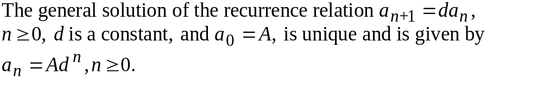
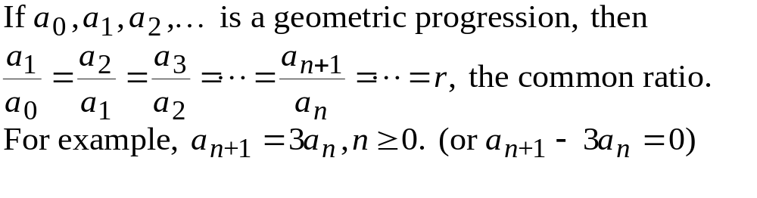
The First-Order Linear Homogeneous Recurrence Relation with constant coefficient
a first-order, linear, and homogeneous recurrence relation
(difference equation) with constant coefficient

Slide 27
Example 1:-
A bank pays 6% (annual) interest on savings, compounding
the interest monthly. If Haile deposits 1000 birr on the first day of
May, how much will this deposit be worth a year later?
Solution:-
Let p_{n} denote the value of deposit at the end of n months.
Then p_{n+1}=p_{n}+(6%/12)p_{n}=1.005p_{n}.
With p₀=1000 birr, we have
p_{n}=p₀(1.005)^{n}. The answer is p₁₂=1000(1.005)¹²=1061.68 birr.
Example 2, Solve the recurrence relation a_{n}=7a_{n-1}, where n≥1 and a₂=98.
  Assume the solution as a_{n}=A7^{n}.

Slide 28
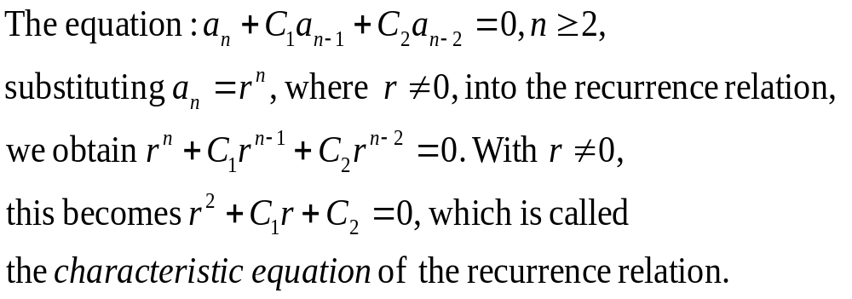

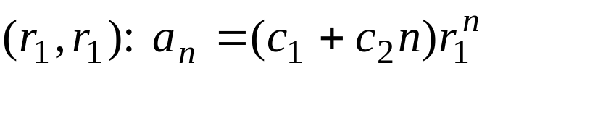
The Second-Order Linear Homogeneous Recurrence Relation with Constant Coefficients
three cases for the characteristic roots:
(a) distinct real numbers
(b) complex conjugates
(c) duplicate roots

Slide 29
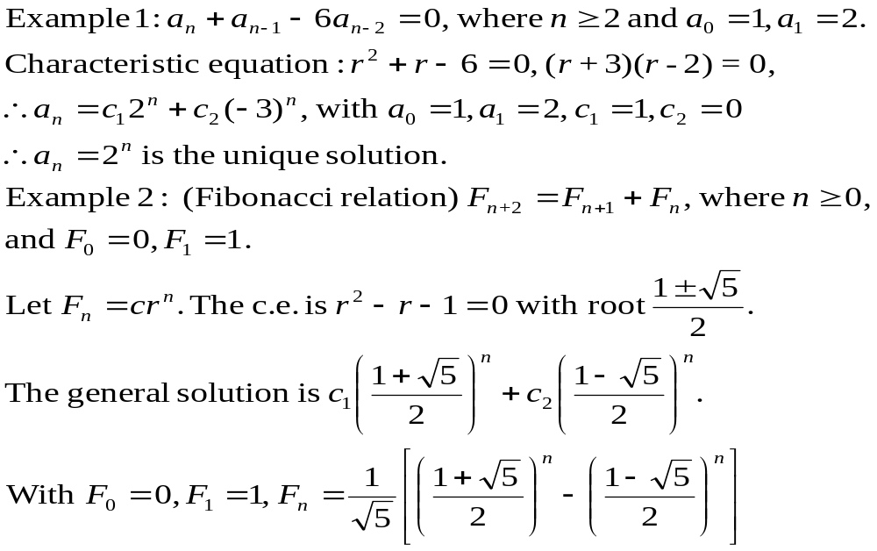
Case (A): distinct real roots

Slide 30
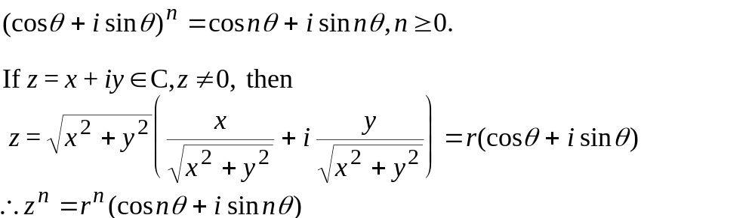
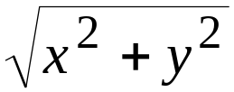

Case (b) Complex Roots
DeMoivre's Theorem
y
x

Slide 31
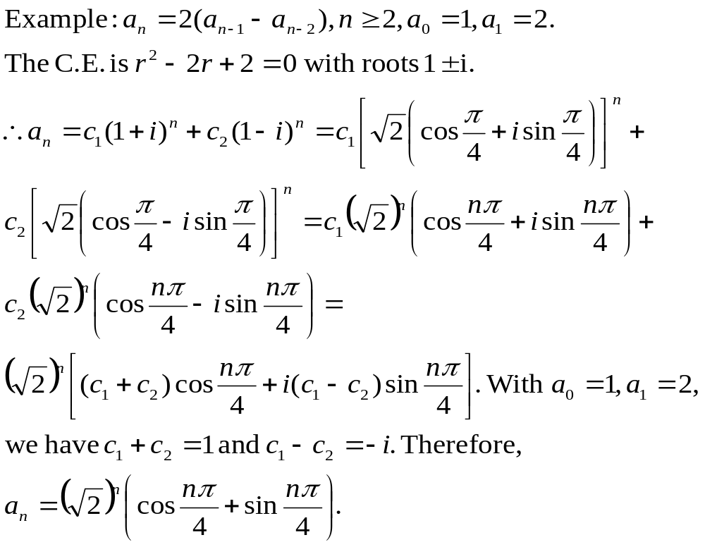

Slide 32
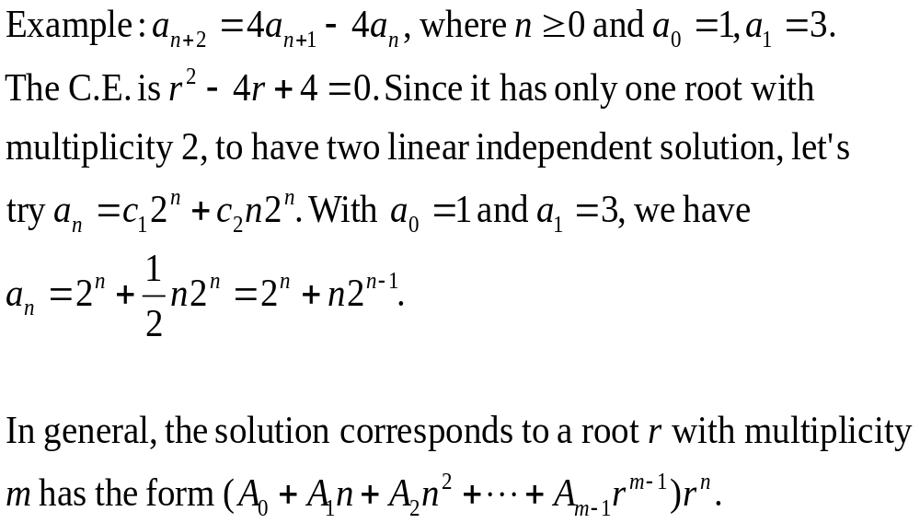
Case (c) Repeated Real Roots

Slide 33


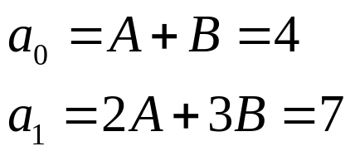
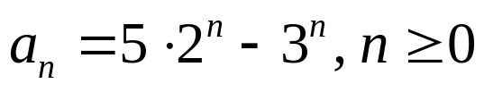
2.2 SOLVING RECURRENCE RELATION
Example: Second-Order LHRRWCCs
Solve the recurrence relation an = 5an-1 - 6an-2 where a0 = 4 and a1 = 7.
Find the general solution of the recurrence relation
  the characteristic equation is given by
  the characteristic roots are 2 and 3
  thus, the general solution is
Find the constant values, A and B using the initial conditions
  Solving the linear system: : A = 5, B = -1
Thus the solution to the recurrence relation and initial conditions is .
Solution:
Notes:
DISCRETE MATHEMATICS & ITS APPLICATIONS
CHAPTER 2

Slide 34



2.2 SOLVING RECURRENCE RELATION
EXERCISE
What is the solution of the following recurrence relation
Find an explicit formula for Fibonacci numbers.
Notes:
DISCRETE MATHEMATICS & ITS APPLICATIONS
CHAPTER 2

Slide 35



2.2 SOLVING RECURRENCE RELATION
Linear Nonhomogeneous Recurrence Relations with constant coefficients
A Linear Nonhomogenous recurrence relation with constant coefficients (LNHRRWCCs), that is a recurrence relation of the form an = c1an-1 + c2an-2 + F (n) .
Where
  c1, c2, are real numbers
  F (n) is a function not identically zero depending only n
  c1an-1 + c2an-2 is called the associated homogenous recurrence relation
Example:
Notes:
DISCRETE MATHEMATICS & ITS APPLICATIONS
CHAPTER 2

Slide 36
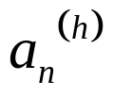
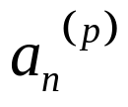
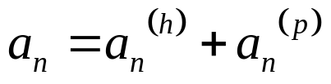
2.2 SOLVING RECURRENCE RELATION
Solving Linear NonHomogenous Recurrence Relations with constant coefficients
Let
be the general solution of c1an-1 + c2an-2
And
be the particular solution of LNHRRWCCs,
an = c1an-1 + c2an-2 + F (n)
Then the general solution of LNHRRWCCs is given by
There is no general method to find the particular solution.
Notes:
DISCRETE MATHEMATICS & ITS APPLICATIONS
CHAPTER 2

Slide 37


2.2 SOLVING RECURRENCE RELATION
THEOREM
Suppose that {a_{n}} satisfy the linear nonhomogeneous recurrence relation
And
When s is not a root of the characteristic equation, there is a particular solution of the form
(ii) When s is a root of the characteristic equation , there is a particular solution of the form
Notes:
DISCRETE MATHEMATICS & ITS APPLICATIONS
CHAPTER 2

Slide 38



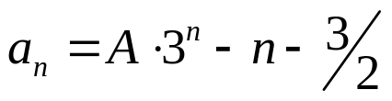
2.2 SOLVING RECURRENCE RELATION
Example : LNHRRWCCs
Find all the solutions of recurrence relation an = 3an-1 + 2n for a0= 3
Find the general solution of the associated linear homogenous (ALH) equation.
  the ALH equation is given by an = 3an-1
  thus, the general solution is
Find the particular solution
  Since F(n) = 2n is polynomial with degree 1, then the trial solution linear function: pn = cn + d (c and d are constant)
  The equation an = 3an-1 + 2n then become
  Solve for c and d will gives c = -1 and d = -3/2
  Thus, the particular solution is
Thus the unique solution to the recurrence relation is
Solution:
Notes:
DISCRETE MATHEMATICS & ITS APPLICATIONS
CHAPTER 2

Slide 39
Example:
Solve the recurrence relation a_{n+2}-4a_{n+1}+3a_{n}=-200 for n≥0 and a₀=3000 and a₁=3300.
The solution for
a_{n+2}-4a_{n-1}+3a_{n}=0 is a_{n}^{(h)}=c₁(3^{n})+c₂.
(Let a_{n}^{(p)}=An) The particular solution for
a_{n+2}-4a_{n-1}+3a_{n}=-200 is a_{n}^{(p)}=100n.
The solution to the problem is a_{n}= c₁(3^{n})+c₂+100n
Finally, we have a_{n}= 100(3^{n})+2900+100n

Slide 40

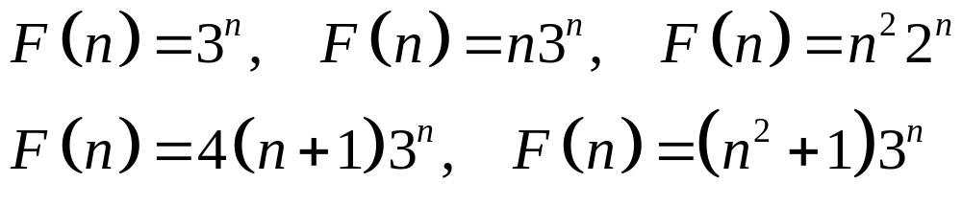
2.2 SOLVING RECURRENCE RELATION
EXERCISE 5
What is the solution of the following recurrence relation
What form does a particular solution of linear nonhomogeneous recurrence relation when
Notes:
DISCRETE MATHEMATICS & ITS APPLICATIONS
CHAPTER 2

